Slide 1
CS 161 Design and Analysis of Algorithms
Lecture 1:
Logistics, introduction, and multiplication!

Slide 2
How was your break?

Slide 3
The big questions
Who are we?
Professor, TAs, students?
Why are we here?
Why learn about algorithms?
What is going on?
What is this course about?
Logistics?
Embedded Ethics?
Can we multiply integers?
And can we do it quickly?

Slide 4

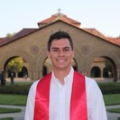
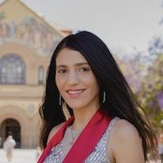
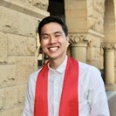



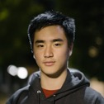







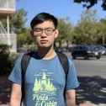


Who are we?
Instructors:
Moses Charikar
Nima Anari
Course Coordinator:
Amelie Byun
Amrita Andre Goli Jerry Jiazheng
Amelie
Jose Manda Nash Peter Sam Samar
Awesome CAs:
Ziang Liu (Head CA)
Peter Boennighausen
Andre Turati
Amrita Palaparthi
Seiji Eicher
Jiazheng Zhao
June Vuong
Yuchen Wang
Emily Wen
Samar Khanna
Avery Wang
Sam Lowe
Nash Luxsuwong
Shubham Jain
Andrew Yang
Jose Francisco
Tim Chirananthavat
Jerry Hong
Teresa Noyola
Goli Emami
Manda Tran
Seiji Shubham Teresa Tim
Yuchen Ziang

Slide 5
Who are you?
Freshman
Sophomores
Juniors
Seniors
MA/MS Students
PhD Students
NDO Students
Concentrating in:
Aero/Astro
Archaeology
Art Practice
Bioengineering
Biology
Biomedical Informatics
Biophysics
Chemical Eng.
Chemistry
Chinese
Civil & Env. Eng.
Classics
Communication
Comparative Lit.
Computer Science
Creative Writing
Earth Systems
East Asian Studies
Economics
Education
EE
Energy Resources Eng.
Engineering
English
Epidemiology
Ethics in Society
Geophysics
History
Human Biology
Human Rights
Immunology
International Relat
Material Sci & Eng
Math & CS
Math
Mech. Eng.
MS&E
Music
Philosophy
Philosophy & Rel Stud
Physics
Political Science
Psychology
Science, Tech. and Society
Slavic Lang & Lit
Sociology
Spanish
Statistics
Symbolic Systems
Undeclared

Slide 6
Where are you?

Slide 7
Why are we here?
I’m here because I’m super excited about algorithms!
Yay Algorithms!

Slide 8
Why are you here?
You are better equipped to answer this question than I am, but I’ll give it a go anyway…
Algorithms are fundamental.
Algorithms are useful.
Algorithms are fun!
CS161 is a required course.
Why is CS161 required?
Algorithms are fundamental.
Algorithms are useful.
Algorithms are fun!

Slide 9
Algorithms are fundamental
The
Algorithmic
Lens
Operating Systems (CS 140)
Machine learning (CS 229)
Cryptography (CS 255)
Compilers (CS 143)
Networking (CS 144)
Computational Biology (CS 262)

Slide 10
Algorithms are useful
All those things without the course numbers.
As inputs get bigger and bigger, having good algorithms becomes more and more important!

Slide 11
Algorithms are fun!
Algorithm design is both an art and a science.
Many surprises!
Many exciting research questions!

Slide 12
What’s going on?
Course goals/overview
Logistics

Slide 13
Course goals
The design and analysis of algorithms
These go hand-in-hand
In this course you will:
Learn to think analytically about algorithms
Flesh out an “algorithmic toolkit”
Learn to communicate clearly about algorithms

Slide 14
Roadmap
More detailed schedule on the website!
5 lectures
Randomized Algs
2 lectures
Asymptotic Analysis
Data structures
Sorting
Today
Divide and conquer
Recurrences
MIDTERM
Dynamic Programming
Greedy Algs
Graphs!
Longest, Shortest, Max and Min…
FINAL
9 lectures
The
Future!
1 lecture

Slide 15

Our guiding questions:
Does it work?
Is it fast?
Can I do better?

Slide 16
Our internal monologue…
What exactly do we mean by better? And what about that corner case? Shouldn’t we be zero-indexing?
Dude, this is just like that other time. If you do the thing and the stuff like you did then, it’ll totally work real fast!
Does it work?
Is it fast?
Can I do better?
Plucky the
Pedantic Penguin
Lucky the
Lackadaisical Lemur
Detail-oriented
Precise
Rigorous
Big-picture
Intuitive
Hand-wavey
Both sides are necessary!

Slide 17
Aside: the bigger picture
Does it work?
Is it fast?
Can I do better?
Should it work?
Should it be fast?
We want to reduce crime.
It would be more “efficient” to put cameras in everyone’s homes/cars/etc.
We want advertisements to reach to the people to whom they are most relevant.
It would be more “efficient” to make everyone’s private data public.
We want to design algorithms, that work well, on average, in the population.
It would be more “efficient” to focus on the majority population.

Slide 18
Course elements and resources
Course website:
cs161.stanford.edu
Lectures
References
IPython Notebooks
Concept Check questions
Homework
Exams
Office hours, recitation sections, and Ed

Slide 19
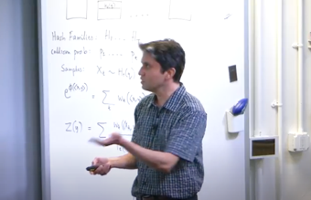
Lectures
Mon/Wed, 9:45-11:15 First 2 weeks: On Zoom (link on canvas) Later: In person (Nvidia auditorium)
Resources available:
Slides, Videos, Notes, IPython notebooks, concept check qns
Videos from lecture are available!
Slides are the slides from lecture.
Hand-outs and references have mathy details that slides may omit
IPython notebooks have implementation details that slides may omit.

Slide 20
How to get the most out of lectures
During lecture:
Participate live (if you can), ask questions.
Engage with in-class questions.
Before lecture:
Do pre-lecture exercises on the website.
After lecture:
Go through the exercises on the slides.
Do the reading
either before or after lecture, whatever works best for you.
do not wait to “catch up” the week before the exam.
Think-Pair-Share Terrapins (in-class questions)
Siggi the Studious Stork
(recommended exercises)
Ollie the Over-achieving Ostrich
(challenge questions)

Slide 21
Optional References
Algorithms Illuminated, Vols 1,2 and 3 by Tim Roughgarden
Additional resources at algorithmsilluminated.org
We may also refer to to the following (optional) books:
”CLRS”: Introduction to Algorithms by Cormen, Leiserson, Rivest, and Stein. Available FOR FREE ONLINE through the Stanford library.
“Algorithm Design” by Kleinberg and Tardos

Slide 22
IPython Notebooks
Lectures will occasionally use IPython notebooks (but not homeworks)
For next lecture, the pre-lecture exercise is to get started with Jupyter Notebooks and with Python.
See course website for details.
The goal is to make the algorithms (and their runtimes) more tangible.

Slide 23
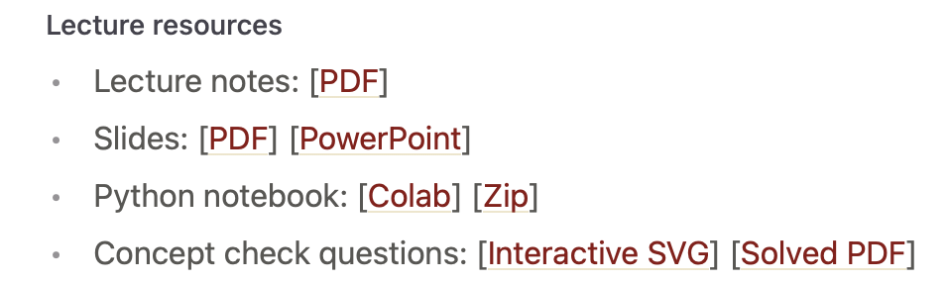
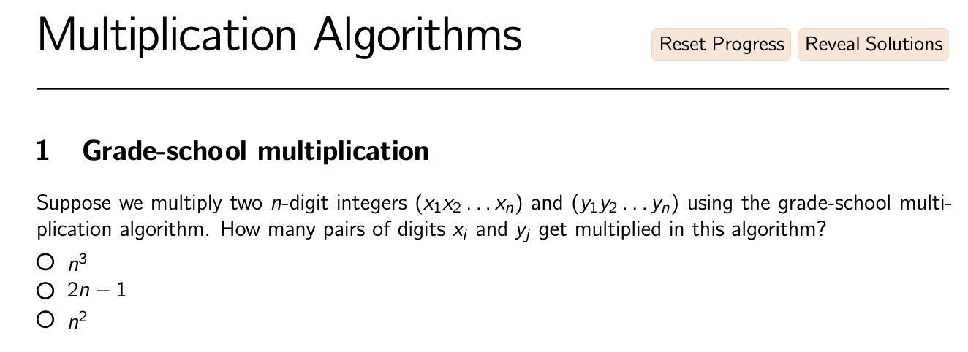
Concept Check questions
Not part of grade; will not be graded
Links to question sets part of resources for each lecture (via Lectures tab on website)

Slide 24
Homework!
Weekly assignments, posted Wednesday by 12:30pm, due the next Wednesday 11:59pm.
First HW posted this Wednesday!

Slide 25
How to get the most out of homework
HW has two parts: exercises and problems.
Do the exercises on your own.
Try the problems on your own before discussing it with classmates.
If you get help from a CA at office hours:
Try the problem first.
Ask: “I was trying this approach and I got stuck here.”
After you’ve figured it out, write up your solution from scratch, without the notes you took during office hours.

Slide 26
Exams
There will be a midterm and a final
Midterm: Mon Feb 7 - Tue Feb 8 (48 hr window)
Final: Wed Mar 16, 3:30pm – 6:30pm
8 homeworks, lowest score dropped
Weighting: HW (50%), Midterm (20%), Final (30%)
If you have a conflict with the midterm time, email
cs161-win2122-staff@lists.stanford.edu ASAP!!!!!

Slide 27

Talk to us!
Ed discussion forum:
Link on top of the course website
Course announcements will be posted there
Discuss material with TAs and your classmates
Office hours (on Nooks):
See course website for schedule
Recitation sections (on Zoom):
Thursdays and Fridays.
See course website for schedule
Technically optional, but highly recommended!
Extra practice with the material, example problems, etc.

Slide 28
Talk to each other!
Answer your peers’ questions on Ed!
We will host Homework Parties (on Nooks).

Slide 29
Course elements and resources
Course website:
cs161.stanford.edu
Lectures
References
IPython Notebooks
Homework
Exams
Office hours, recitation sections, and Ed

Slide 30

A note on course policies
Course policies are listed on the website.
Read them and adhere to them.
That’s all I’m going to say about course policies (except for a couple of slides on collaboration and the honor code)

Slide 31
Collaboration
We encourage collaboration on homeworks (but strongly recommend you do exercises on your own)
Valid and invalid modes of collaboration detailed on the course website.
Briefly, you can exchange ideas with classmates, but must write up solutions on your own.
You must cite all collaborators, as well as all sources used (outside of course materials).

Slide 32
Honor code
Updated last year: “In all cases, it is not permissible for students to enter exam questions into any software, apps, or websites. Accessing resources that directly explain how to answer questions from the actual assignment or exam is a violation of the Honor Code.” https://communitystandards.stanford.edu/bja-guidance-remote-teaching-and-learning-environment
Course policy for Homeworks: “In all cases, it is not permissible for students to enter homework questions into any software, apps, or websites. Accessing resources that directly explain how to answer questions from the actual assignment or exam is a violation of course policy.”

Slide 33
Bug bounty!
We hope all PSETs and slides will be bug-free.
Howover, we sometmes maek typos.
If you find a typo (that affects understanding*) on slides, IPython notebooks, Section material or PSETs:
Let us know! (Post on Ed or tell a CA).
The first person to catch a bug gets a bonus point.
Bug Bounty Hunter
*So, typos lke thees onse don’t count, although please point those out too. Typos like 2 + 2 = 5 do count, as does pointing out that we omitted some crucial information.

Slide 34
For SCPD Students (and all students)
All/some office hours held online (on Nooks)
One of the recitation sections will be recorded.
See the website for more details! (Coming soon…)

Slide 35
OAE forms
Please send OAE forms to
cs161-win2122-staff@lists.stanford.edu

Slide 36
Feedback!
We will have an anonymous feedback form on the course website (top of the main page).
Please help us improve the course!

Slide 37
How are you approaching CS 161?

Slide 38
Everyone can succeed in this class!
Work hard
Work smart
Ask for help
CS 161A one unit supplementary class (deadline to apply: Fri Jan 7, 5pm PST)

Slide 39
The big questions
Who are we?
Professor, TA’s, students?
Why are we here?
Why learn about algorithms?
What is going on?
What is this course about?
Logistics?
Embedded Ethics?
Can we multiply integers?
And can we do it quickly?

Slide 40
Introducing Embedded Ethics
Diana Acosta-Navas
Postdoctoral Fellow, McCoy Family Center for Ethics in Society and Institute for Human Centered Artificial Intelligence

Slide 41
Other big questions
Who am I?
Why am I here?
What is Embedded Ethics?
What has ethics got to do with algorithms?

Slide 42
Who am I?
I’m Diana, a post-doctoral fellow at the McCoy Family Center for Ethics in Society and Stanford Institute for Human-Centered Artificial Intelligence
I finished my Ph.D. in Philosophy at Harvard University
I taught ethics at the Harvard Kennedy School of Government
I also became part of Embedded EthiCS@Harvard
Now I’m helping Stanford to develop our Embedded Ethics program

Slide 43
What is Embedded Ethics?
Training the next generation of computer scientists to “consider ethical issues from the outset rather than building technology and letting problems surface downstream” by integrating skills and habits of ethical analysis throughout the Stanford Computer Science curriculum.
Elan the Ethical Emu

Slide 44
What is Embedded Ethics?
The Vision
Responsible ethical reasoning is a highly valuable skill.
One that needs to be integrated with technical, managerial, and other skills we apply in our professional lives
Successfully integrating these skills requires a distributed pedagogy approach
Elan the Ethical Emu

Slide 45
What is Embedded Ethics?
What we teach
Issue spotting and ethical sensitivity.
Recognizing values in design choices.
Developing language to talk about moral choices.
Professional responsibilities of computer scientists & software engineers.
Important topics in technology ethics: bias & fairness, inequality, privacy, surveillance, data control & consent, trust, disinformation, participatory design, concentration of power.
Elan the Ethical Emu

Slide 46
Where is Embedded Ethics?
Outside Stanford
At Stanford
Harvard (2017)
Georgetown (2017)
Brown (2019)
Northeastern (2019)
MIT (2020)
Andover (2021)
… and many other places
CS106A
CS106B
CS107
CS109
CS221
CS247
CS147
... and more over the next two years

Slide 47
And what does ethics have to do with algorithms?

Slide 48
If algorithms are fundamental (which they are) …
Then some of the most consequential choices you will make as computer scientists are:
Deciding which problem to solve
This often is a huge ethical question
Deciding how to turn that problem into something algorithmically tractable
This also can involve serious ethical decisions
Deciding which algorithm to use to solve it and what tradeoffs to accept
Which often requires ethical reasoning

Slide 49
Algorithms & the Good
Turn a real-world problem into a formal problem
Use an algorithm to solve the problem
Happiness ensues

Slide 50
Algorithms & the Good
Turn a real-world problem into a formal problem
Use an algorithm to solve the problem
Happiness ensues

Slide 51
Some (potentially impactful) decisions:
We often need to ignore or change aspects of a real-world situation in order to turn it into an algorithmically solvable problem. For example, we can write an algorithm that sorts a numbered list without knowing what the numbers are numbers of.
Abstraction is when we omit details of the real-world situation.
Omit the kind of thing being sorted by our algorithm, or what condition it is in, or what color it is, or how long it has been in the list.
Idealization is when we deliberately change aspects of the real-world situation.
Round the numbers being sorted to make them whole numbers.

Slide 52
Real-world problem? I don’t see you all the way over there …
Turn a real-world problem into a formal problem
Use an algorithm to solve the problem
Happiness ensues

Slide 53
So how do we make sure we aren’t losing important features of the real-world problem when we formalize it?
Turn a real-world problem into a formal problem
Use an algorithm to solve the problem
Happiness ensues

Slide 54
By the time you finish 161 you will have an “algorithmic tool kit”– which one is right for the job?
Turn a real-world problem into a formal problem
Use an algorithm to solve the problem
Happiness ensues

Slide 55
Did we achieve what we set out achieve in the first place? What did we lose along the way? Is this a desirable outcome?
Turn a real-world problem into a formal problem
Use an algorithm to solve the problem
Happiness –or something– ensues

Slide 56

Our guiding questions:
Does it work?
Is it fast?
Can I do better?
Can I do it right?

Slide 57
Thank you!
You can always email me at dacostan@stanford.edu

Slide 58
The big questions
Who are we?
Professor, TA’s, students?
Why are we here?
Why learn about algorithms?
What is going on?
What is this course about?
Logistics?
Embedded Ethics?
Can we multiply integers?
And can we do it quickly?

Slide 59
Today’s goals
Course goals
Think analytically about algorithms
Flesh out an “algorithmic toolkit”
Learn to communicate clearly about algorithms
Karatsuba Integer Multiplication
Algorithmic Technique:
Divide and conquer
Algorithmic Analysis tool:
Intro to asymptotic analysis

Slide 60
Let’s start at the beginning

Slide 61
Etymology of “Algorithm”
Al-Khwarizmi was a 9th-century scholar, born in present-day Uzbekistan, who studied and worked in Baghdad during the Abbassid Caliphate.
Among many other contributions in mathematics, astronomy, and geography, he wrote a book about how to multiply with Arabic numerals.
His ideas came to Europe in the 12th century.
Dixit algorizmi
(so says Al-Khwarizmi)
Originally, “Algorisme” [old French] referred to just the Arabic number system, but eventually it came to mean “Algorithm” as we know today.
Notes:
So in some sense, the grade-school multiplication algorithm is the ultimate “algorithm!”

Slide 62
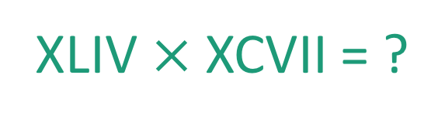
This was kind of a big deal
44
97
XLIV $×$XCVII = ?
x

Slide 63
Integer Multiplication
44
97
x

Slide 64
Integer Multiplication
1234567895931413
4563823520395533
x

Slide 65

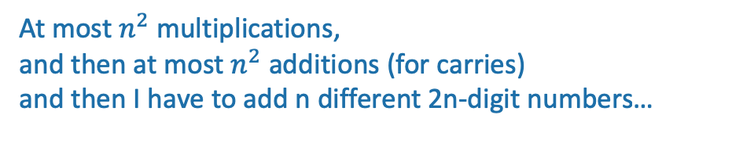
Integer Multiplication
n
1233925720752752384623764283568364918374523856298
4562323582342395285623467235019130750135350013753
x
How fast is the grade-school multiplication algorithm?
???
(How many one-digit operations?)
About $n^{2}$one-digit operations
Think-pair-share Terrapins
At most $n^{2}$multiplications,
and then at most $n^{2}$ additions (for carries)
and then I have to add n different 2n-digit numbers…
Plucky the Pedantic Penguin

Slide 66
Big-Oh Notation
We say that Grade-School Multiplication
“runs in time O(n²)”
Formal definition coming Wednesday!
Informally, big-Oh notation tells us how the running time scales with the size of the input.

Slide 67
Implemented in Python, on my laptop
highly non-optimized
The runtime “scales like” n²
Looks like it’s roughly
T_{laptop}(n) = 0.0063 n² – 0.5 n + 12.7 ms...

Slide 68

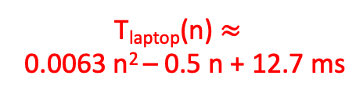
Implemented by hand
The runtime still “scales like” n²
Some other quadratic function of n
T_{laptop}(n) $≈$
0.0063 n² – 0.5 n + 12.7 ms
Notes:
It totally takes me less than 30 seconds to multiply two 500-digit numbers…

Slide 69

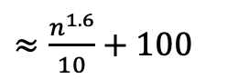
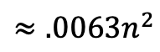
Why is big-Oh notation meaningful?
Wizard’s algorithm
$≈\frac{n^{1.6}}{10}+100$
$$≈.0063n^{2}$$
Notes:
It totally takes me less than 30 seconds to multiply two 500-digit numbers…

Slide 70
Let n get bigger…
$≈\frac{n^{1.6}}{10}+100$
Time (ms)
$$≈.0063n^{2}$$
Wizard’s algorithm

Slide 71
Take-away
An algorithm that runs in time O(n^{1.6}) is “better” than an algorithm that runs in time O(n²).
So the question is…

Slide 72
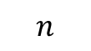
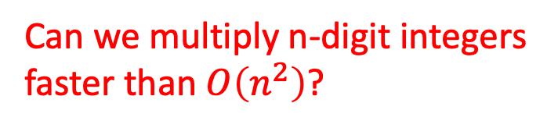
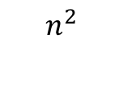
Can we do better?
Can we multiply n-digit integers faster than $O\left(n^{2}\right)$?
$$n^{2}$$
$$n$$

Slide 73
Let’s dig in to our algorithmic toolkit…

Slide 74
Divide and conquer
Break problem up into smaller (easier) sub-problems
Big problem
Smaller problem
Smaller problem
Yet smaller problem
Yet smaller problem
Yet smaller problem
Yet smaller problem

Slide 75
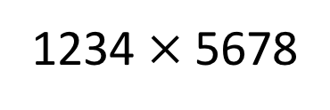
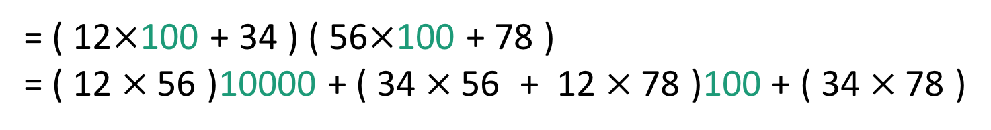
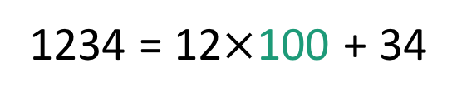
Divide and conquer for multiplication
Break up an integer:
1234 = 12$×$100 + 34
1234$×$5678
= ( 12$×$100 + 34 ) ( 56$×$100 + 78 )
= ( 12$×$56 )10000 + ( 34$×$56 + 12$×$78 )100 + ( 34$×$78 )
1
2
3
4
One 4-digit multiply
Four 2-digit multiplies

Slide 76
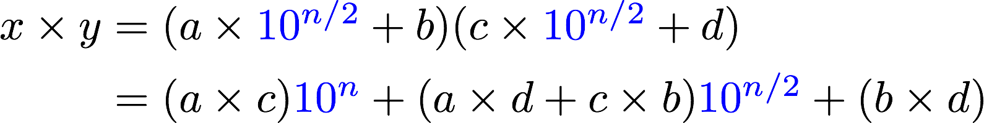
More generally
Suppose n is even
Break up an n-digit integer:
1
2
3
4
One n-digit multiply
Four (n/2)-digit multiplies

Slide 77
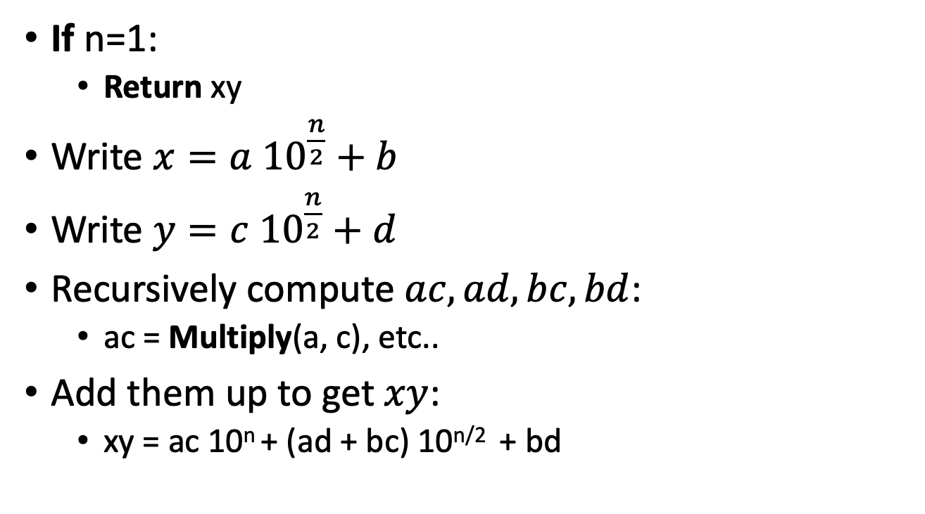
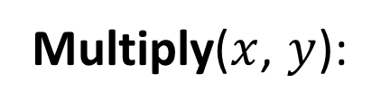
Divide and conquer algorithm not very precisely…
x,y are n-digit numbers
(Assume n is a power of 2…)
Multiply($x$, $y$):
Base case: I’ve memorized my 1-digit multiplication tables…
If n=1:
Return xy
Write $x=a {10}^{\frac{n}{2}}+b$
Write $y=c {10}^{\frac{n}{2}}+d$
Recursively compute $ac, ad,bc,bd$:
ac = Multiply(a, c), etc..
Add them up to get $xy$:
xy = ac 10^{n} + (ad + bc) 10^{n/2} + bd
a, b, c, d are
n/2-digit numbers
Make this pseudocode more detailed! How should we handle odd n? How should we implement “multiplication by 10^{n}”?
See the Lecture 1 Python notebook for actual code!
Siggi the Studious Stork

Slide 78
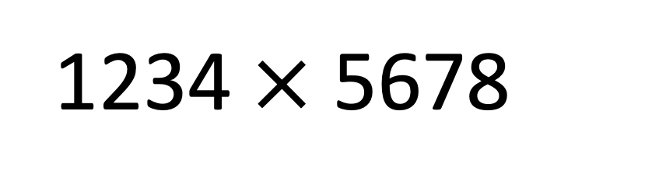
Think-Pair-Share
We saw that this 4-digit multiplication problem broke up into four 2-digit multiplication problems
If you recurse on those 2-digit multiplication problems, how many 1-digit multiplications do you end up with total?
1234$×$5678

Slide 79
Recursion Tree
16 one-digit multiplies!
4 digits
2 digits
2 digits
2 digits
2 digits
1 digit
1 digit
1 digit
1 digit
1 digit
1 digit
1 digit
1 digit
1 digit
1 digit
1 digit
1 digit
1 digit
1 digit
1 digit
1 digit

Slide 80
What is the running time?
Better or worse than the grade school algorithm?
How do we answer this question?
Try it.
Try to understand it analytically.

Slide 81
1. Try it.
Check out the Lecture 1 IPython Notebook
Conjectures about running time?
Doesn’t look too good but hard to tell…
Maybe one implementation is slicker than the other?
Maybe if we were to run it to n=10000, things would look different.
Something funny is happening at powers of 2…

Slide 82
2. Try to understand the running time analytically
Proof by meta-reasoning:
It must be faster than the grade school algorithm, because we are learning it in an algorithms class.
Not sound logic!
Plucky the Pedantic Penguin

Slide 83
2. Try to understand the running time analytically
Think-Pair-Share:
We saw that multiplying 4-digit numbers resulted in 16 one-digit multiplications.
How about multiplying 8-digit numbers?
What do you think about n-digit numbers?

Slide 84
Recursion Tree
64 one-digit multiplies!
8 digits
4 digits
4 digits
4 digits
4 digits
2 digit
2 digit
2 digit
2 digit
2 digit
2 digit
2 digit
2 digit
2 digit
2 digit
2 digit
2 digit
2 digit
2 digit
2 digit
2 digit
1
1
1
1
1
1
1
1
1
1
1
1
1
1
1
1
1
1
1
1
1
1
1
1
1
1
1
1
1
1
1
1
1
1
1
1
1
1
1
1
1
1
1
1
1
1
1
1
1
1
1
1
1
1
1
1
1
1
1
1
1
1
1
1

Slide 85
2. Try to understand the running time analytically
Claim:
The running time of this algorithm is
AT LEAST n² operations.

Slide 86
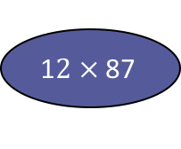
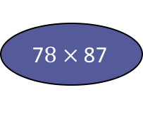
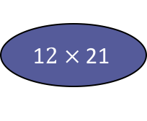
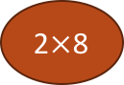
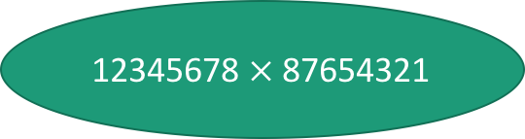
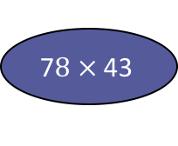
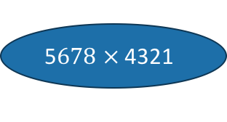
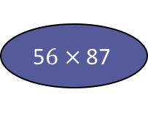
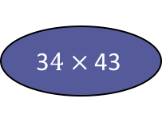
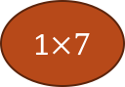
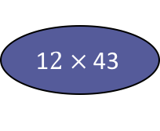
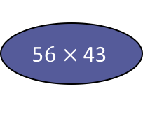
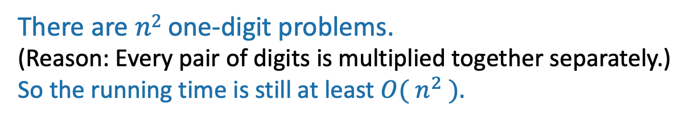
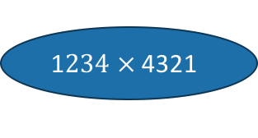
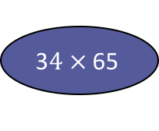
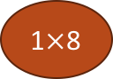
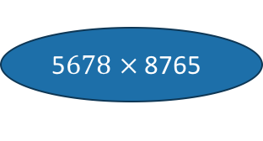
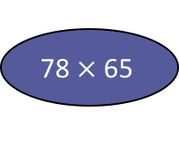
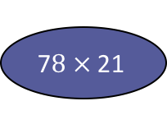
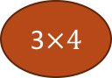
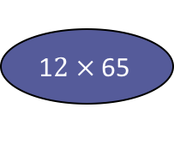
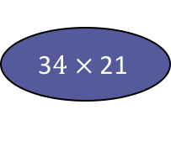
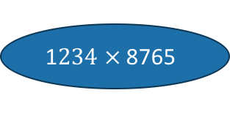
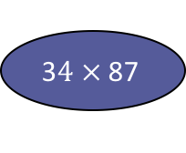
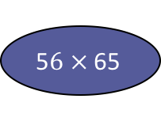

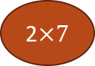
How many one-digit multiplies?
This slide skipped in class, here in case this view is more helpful for you.
12345678 $×$ 87654321
1$234 ×$ 8765
5$678 ×$ 8765
1$234 ×$ 4321
5$678 ×$ 4321
1$2 ×$ 87
5$6 ×$ 87
1$2 ×$ 43
5$6 ×$ 43
3$4 ×$ 87
7$8 ×$ 87
3$4 ×$ 43
7$8 ×$ 43
1$2 ×$ 65
5$6 ×$ 65
1$2 ×$ 21
5$6 ×$ 21
3$4 ×$ 65
78$×$ 65
3$4 ×$ 21
7$8 ×$ 21
…
3$×4$
…
1$×$8
1$×7$
2$×$8
There are $n2$ one-digit problems.
(Reason: Every pair of digits is multiplied together separately.)
So the running time is still at least ${O( n}^{2} ).$
2$×7$
etc...

Slide 87
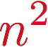

There are n² 1-digit problems
1 problem
of size n
If you cut n in half $log2(n)$times, you get down to 1.
So at level
$t= log2(n)$
we get…
$4^{\log_{2}{n}} =n^{\log_{2}{4}}= n2$
problems of size 1.
4 problems
of size n/2
…
4^{t} problems
of size n/2^{t}
Note: this is just a cartoon – I’m not going to draw all 4^{t} circles!
…
____ problems
of size 1

Slide 88

That’s a bit disappointing All that work and still (at least) $O\left(n^{2}\right)$…
$$n^{2}$$
But wait!!
$$n$$

Slide 89

Divide and conquer can actually make progress
Karatsuba figured out how to do this better!
If only we could recurse on three things instead of four…
Need these three things

Slide 90
Karatsuba integer multiplication
Recursively compute these THREE things:
ac
bd
(a+b)(c+d)
Subtract these off
get this
(a+b)(c+d) = ac + bd + bc + ad
Assemble the product:

Slide 91

How would this work?
(Still not super precise, see IPython notebook for detailed code. Also, still assume n is a power of 2.)
x,y are n-digit numbers
Multiply($x$, $y$):
If n=1:
Return xy
Write $x=a {10}^{\frac{n}{2}}+b$ and $y=c {10}^{\frac{n}{2}}+d$
ac = Multiply(a, c)
bd = Multiply(b, d)
z = Multiply(a+b, c+d)
xy = ac 10^{n} + (z – ac - bd) 10^{n/2} + bd
Return xy
a, b, c, d are
n/2-digit numbers

Slide 92


What’s the running time?
1 problem
of size n
If you cut n in half $log2(n)$times, you get down to 1.
So at level
$t= log2(n)$
we get…
$$3^{\log_{2}{n}}=n^{\log_{2}{3}}≈n^{1.6}$$
problems of size 1.
3 problems
of size n/2
…
3^{t} problems
of size n/2^{t}
Note: this is just a cartoon – I’m not going to draw all 3^{t} circles!
…
We aren’t accounting for the work at the higher levels! But we’ll see later that this turns out to be okay.
$$n^{1.6}$$
____ problems
of size 1

Slide 93


This is much better!
$$n^{2}$$
$$n^{1.6}$$
$$n$$

Slide 94
We can even see it in real life!

Slide 95

Can we do better?
Toom-Cook (1963): instead of breaking into three n/2-sized problems, break into five n/3-sized problems.
Runs in time $O\left(n^{1.465}\right)$
Schönhage–Strassen (1971):
Runs in time $O(n\log\left(n\right)\log{\log\left(n\right)) }$
Furer (2007)
Runs in time $n\log\left(n\right)⋅2^{{O(log}^{∗}\left(n\right)) }$
Harvey and van der Hoeven (2019)
Runs in time $O(n\log\left(n\right))$
Try to figure out how to break up an n-sized problem into five n/3-sized problems! (Hint: start with nine n/3-sized problems).
Given that you can break an n-sized problem into five n/3-sized problems, where does the 1.465 come from?
Siggi the Studious Stork
Ollie the Over-achieving Ostrich
[This is just for fun, you don’t need to know these algorithms!]

Slide 96
Today’s goals
Course goals
Think analytically about algorithms
Flesh out an “algorithmic toolkit”
Learn to communicate clearly about algorithms
Karatsuba Integer Multiplication
Algorithmic Technique:
Divide and conquer
Algorithmic Analysis tool:
Intro to asymptotic analysis

Slide 97
How was the pace today?

Slide 98
The big questions
Who are we?
Professor, TA’s, students?
Why are we here?
Why learn about algorithms?
What is going on?
What is this course about?
Logistics?
Can we multiply integers?
And can we do it quickly?
Wrap-up

Slide 99
Wrap up
cs161.stanford.edu
Algorithms are fundamental, useful and fun!
In this course, we will develop both algorithmic intuition and algorithmic technical chops
Karatsuba Integer Multiplication:
You can do better than grade school multiplication!
Example of divide-and-conquer in action
Informal demonstration of asymptotic analysis

Slide 100
Next time
Sorting!
Asymptotics and (formal) Big-Oh notation
Divide and Conquer some more
BEFORE Next time
Pre-lecture exercise! On the course website!

